Slide 1

SMART IRRIGATION SYSTEM
Group Code: A-3
Team Members:
2019250 Mr. Mohammed Saad Khan
2019225 Mr. Malik Munib
2019178 Mr. Hasnain Ali
Supervisor
Dr. Farhan Khan Co-supervisor
Dr. Dur-e-Zehra
Faculty of Computer Sciences and Engineering Ghulam Ishaq Khan Institute of Engineering Sciences and Technology, Pakistan

Slide 2
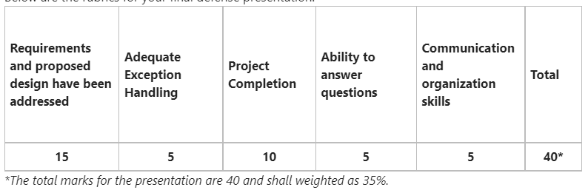
RUBRICS TABLE

Slide 3
A Quick Recap (Requirements)
The interfacing of sensors with Arduino and their calibration.
Data acquisition from sensors.
Wireless transmission of the data using GSM900A.
Displaying the real-time data on thingspeak in graph for visualization. Also available in CSV form.
PCB design and implementation for the project.
Mechanical design for the RC servo and ½ inch ball valve and plan to make it work.

Slide 4
RECAP BILL OF MATERIALS
S no. | Components | Price(Rs.) | Quantity
1 | DS3225 25 KG 6-volt RC servo | 2850 | 1
2 | SIM900A GSM module | 2500 | 1
3 | 12 V 5 A power supply | 750 | 1
4 | Step down 5 A XL4015 buck converter | 250 | 1
5 | DHT22 temperature and humidity sensor | 800 | 1
6 | Arduino UNO R3 SMD board kit with usb cable | 1250 | 1
7 | Rain Drop detection sensor module | 150 | 1
8 | Soil moisture sensor for arduino | 180 | 1
 | Total Price: | 8730

Slide 5
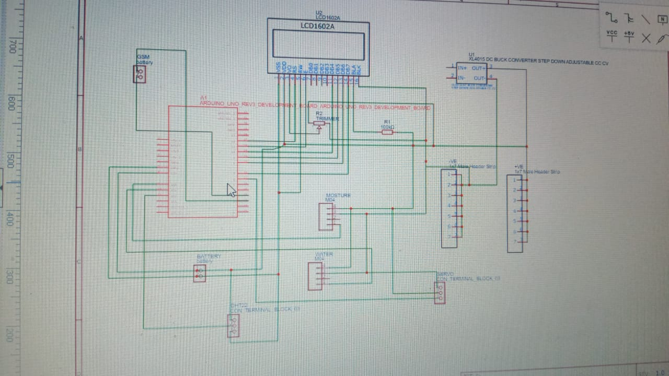
Project Schematics

Slide 6
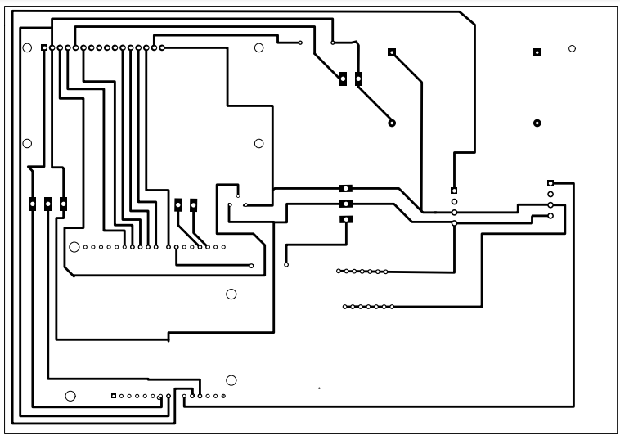
PCB Design
LCD
BUCK CONVERTER
POWER IN 5V 5.2 A
DHT 22
POWER RAIL
ARDUINO
SIM 900A

Slide 7
Water Resource Management
Initial plan was to use MOSFET driver IRF520 to drive proportional solenoid valve for water flow control then we planned to use ½ inch ball valve and 25 kg RC servo with a mechanical assembly of 3d printed parts.
We are now using ½ inch ball valve and 25 kg RC servo with a mechanical assembly from the mechanical workshop using a coupling and mounts.
Trial and error method.

Slide 8
Problem with proportional solenoid valve…
Proportional solenoid valve is not easy to acquire as it is quite expensive so it is not a viable solution to the problem.
One proportional solenoid valve costs approximately anywhere between 250-600 usd for a normal grade valve to industrial grade valve.
Approximately, 65,300 to 156,920 pkr which is out of reach for the average person.
Also, the valves are not available in required size which is a problem.

Slide 9
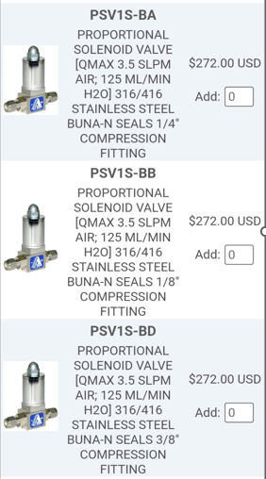
Price Description

Slide 10
Substitute for proportional solenoid valve
We are now using a RC servo, coupling and mounts from mechanical workshop.
This assembly helps to perform the task of water flow control according to the requirement.
Previously we were trying to use 3d printed parts
There were multiple mechanical designs under consideration for this purpose.
The current design was feasible and more rigid than previously planned.
The main components of this design are briefly discussed below.

Slide 11
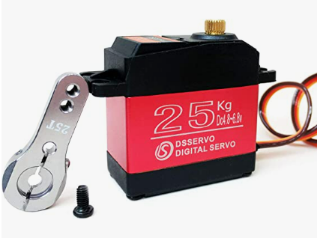
Components
RC Servo

Slide 12
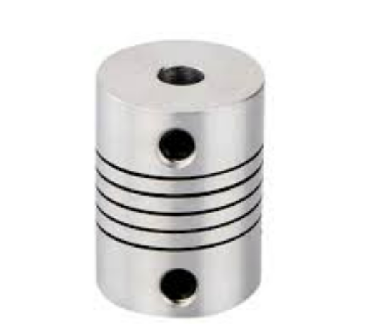
Coupling

Slide 13
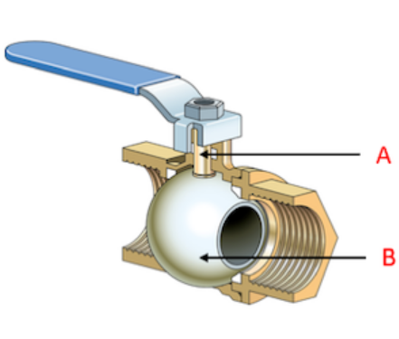
Ball valve

Slide 14
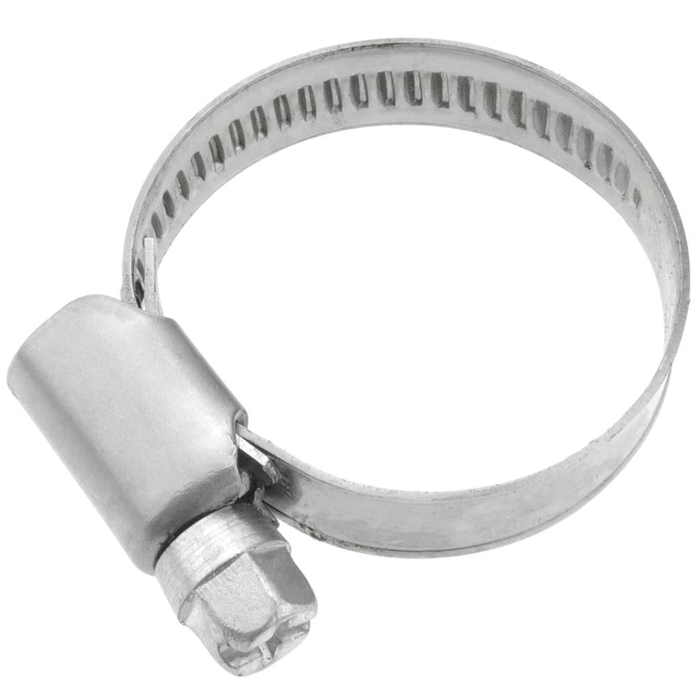
Metal clamps

Slide 15
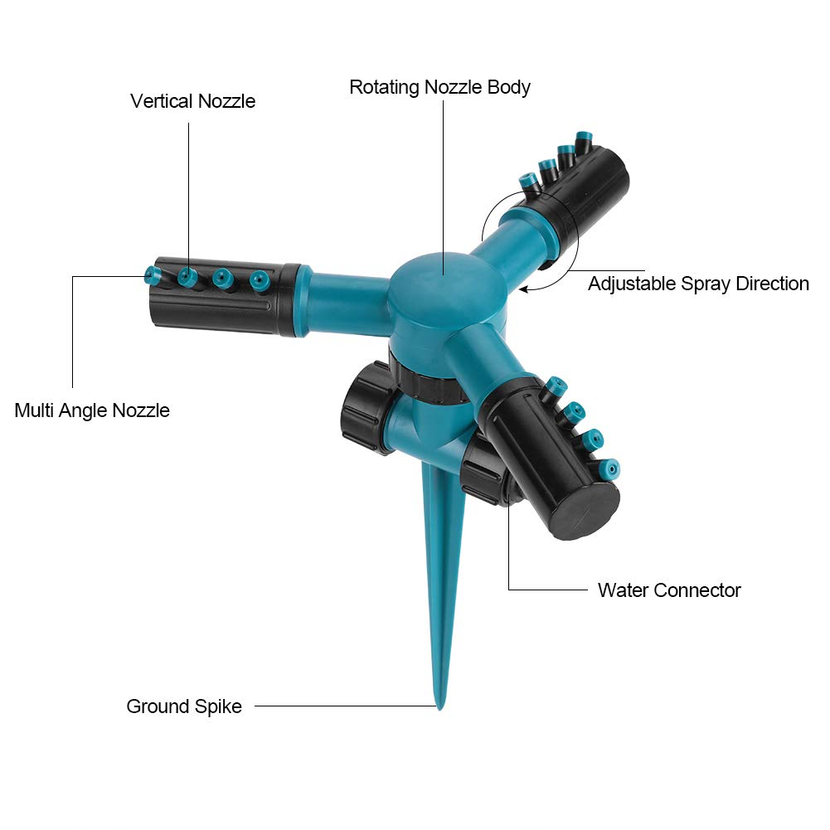
360 degree rotating Sprinkler and Garden Hose

Slide 16
Cost analysis breakdown of valve
Proportional solenoid valve in the market costs around 75,000-100,000 pkr.
Previously, the design we propose involving RC servo, ball valve, mechanical parts costs only Rs. 4850 . This includes the cost of 3d printing as well.
Now our valve only cost us RS 2850(RC Servo)+167(Valve)+575(Coupling) = RS 3592
This improves the cost efficiency of our design making it more feasible for the user.

Slide 17
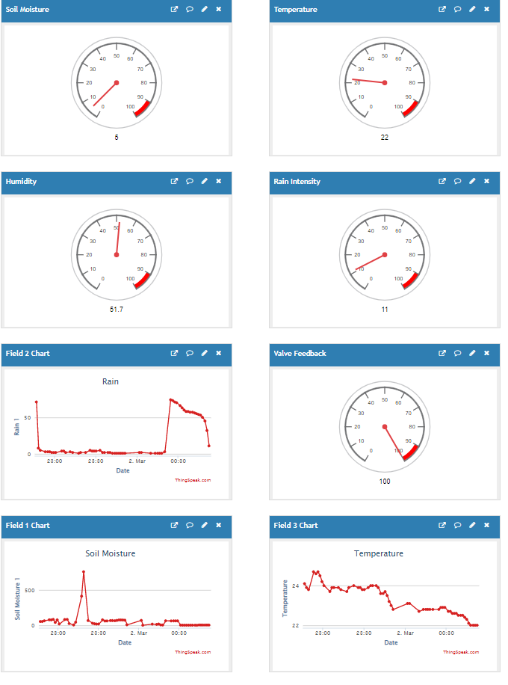
Things Speak

Slide 18

Project Management Tool

